Slide 1
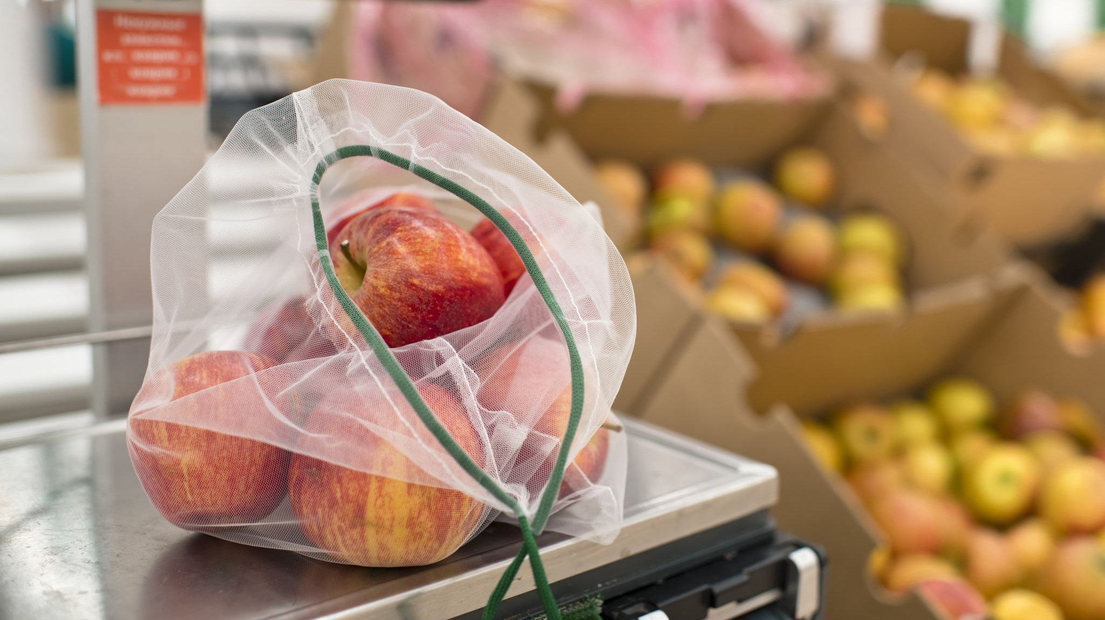
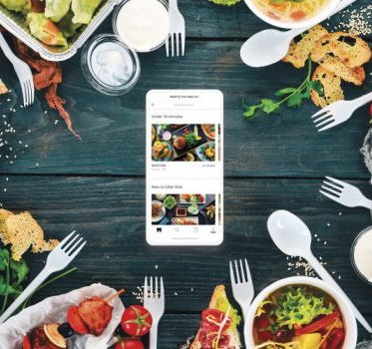
Unified Food Delivery Operations
This Photo by Unknown author is licensed under CC BY-SA-NC.

Slide 2

SUBMITTED BY:
SUBMITTED TO:
Prof.Vaishnavi
Dept. of CS&E, JSS STU Mysore
PRASHANTH M 01JCE21CS074
SHARATH HK 01JCE21CS090
M V NAGAVARDHAN VASIST 01JCE21CS058

Slide 3

ABSTRACT
Significance: Integration of food delivery operations vital for efficiency and customer satisfaction.
Concept: Unified food delivery operations streamline order processing, logistics, inventory, and customer service.
Benefits: Centralization optimizes resource allocation, minimizes errors, and reduces delivery times.
Strategic Approach: Advanced technology and planning enhance operational efficiency.

Slide 4
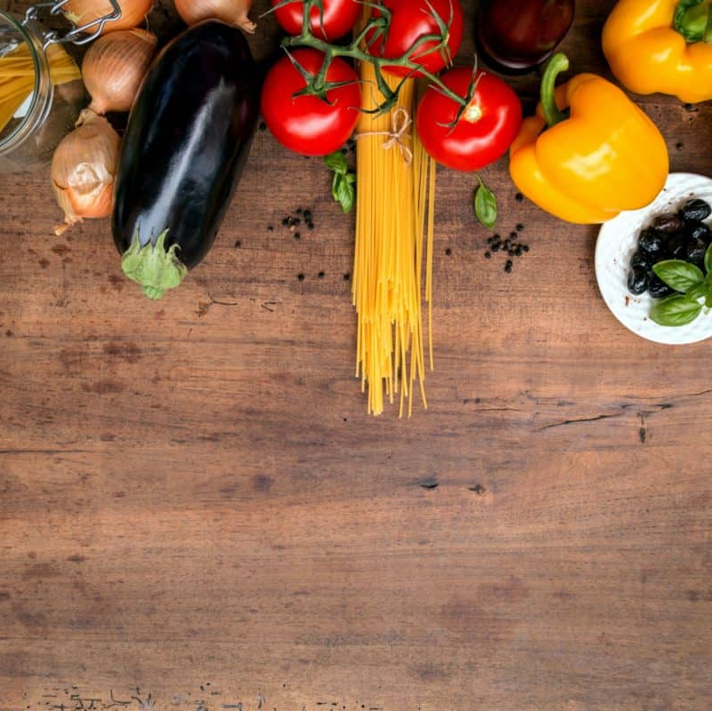
INTRODUCTION​
Unified Food Delivery Operations: Integration of food delivery elements into one system.
Objective: Streamline food delivery processes from order to delivery.
Components: Order management, delivery logistics, fleet management, customer service.
Benefits: Enhanced efficiency, cost savings, improved customer experience, data-driven insights.
Key Players: Restaurants, delivery partners, technology providers, customers.
Challenges: Integration complexity, operational coordination.

Slide 5

LITERATURE REVIEW
Unified food delivery systems integrate order management, delivery logistics, and customer service for efficiency.
Empirical studies show improved delivery times and cost savings, despite integration complexities.
Theoretical frameworks emphasize transformative potential and practical implications.
Collaboration and innovation are crucial for optimizing food delivery, guided by ongoing research.

Slide 6

LIMITATIONS OF THE PRESENT WORK
Integration complexity may hinder the seamless merging of diverse technological platforms.
Operational coordination challenges may arise among stakeholders like restaurants and delivery partners.
Ensuring scalability and adaptability to changing market demands poses a significant concern for the unified food delivery system.

Slide 7

OBJECTIVES
1. EFFICIENCY ENHANCEMENT:
Streamline operations to minimize redundancies and improve efficiency.
2. CUSTOMER SATISFACTION:
Enhance the delivery experience by reducing errors and delivery times.
3. COST REDUCTION:
Consolidate resources to lower operational costs and increase profitability.
4. SCALABILITY:
Develop a flexible system adaptable to changing demands for long-term sustainability.

Slide 8
SOFTWARE REQUIREMENTS
HARDWARE REQUIREMENTS
1. Integrated Development Environment (IDE):- Visual Studio Code​
​
2. Frontend Technologies:​
- HTML: For creating the structure of web pages.​
- CSS: For styling and formatting the appearance of web pages.​
- JavaScript: For implementing interactivity and dynamic functionality.​
​
3. Backend Technologies:​
- Node.js with Express.js (OR)​
- PHP ​
​
4. Database Management System (DBMS):​
- MySQL​
​
5. Version Control System: GIT and GITHUB​
​
6. Web Server: XAMPP​
​
7. Payment Gateway Integration: PayPal (OR) Stripe​
​
8. Hosting: Github
1. Web Server:​
- High-performance hardware for hosting.​
​
2. Database Server:​
- Dedicated storage for website data.​
​
3. Load Balancer :​
- Distributes traffic evenly among servers.​
​
4. Networking Equipment:​
- Reliable connectivity and security measures.​
​
5. Backup and Disaster Recovery:​
- Data protection and business continuity.​
​
6. Monitoring and Management Tools:​
- Oversight and optimization of infrastructure

Slide 9
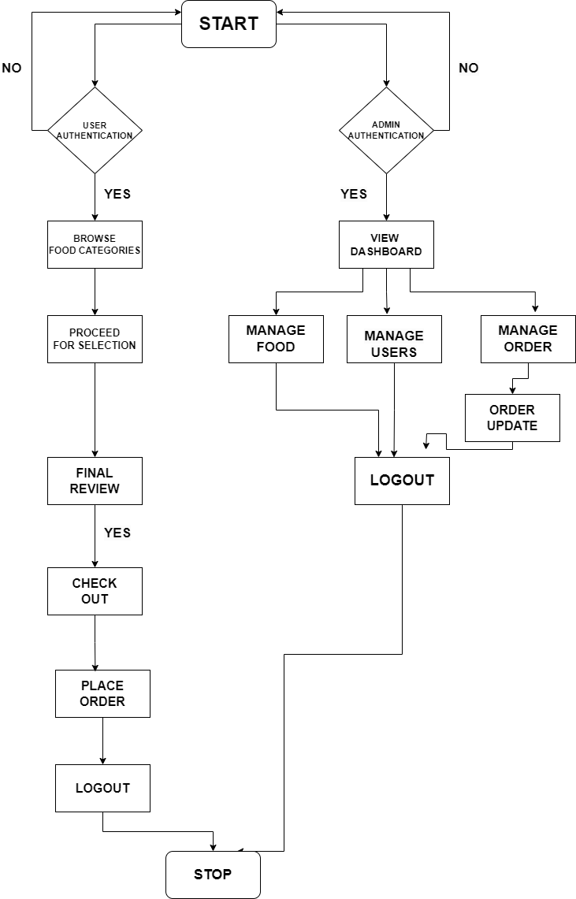
DATA FLOW DIAGRAM​

Slide 10
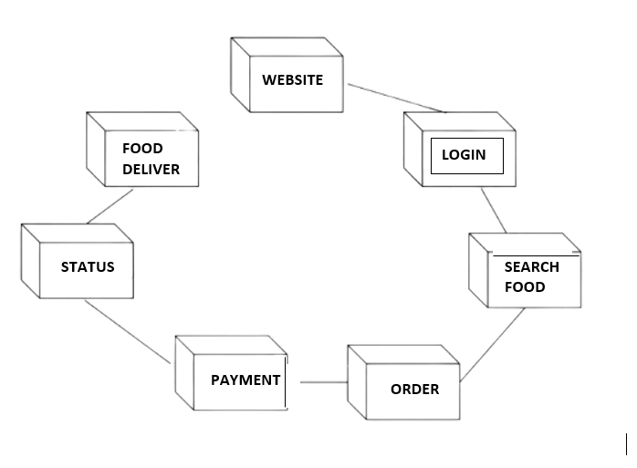

Slide 11
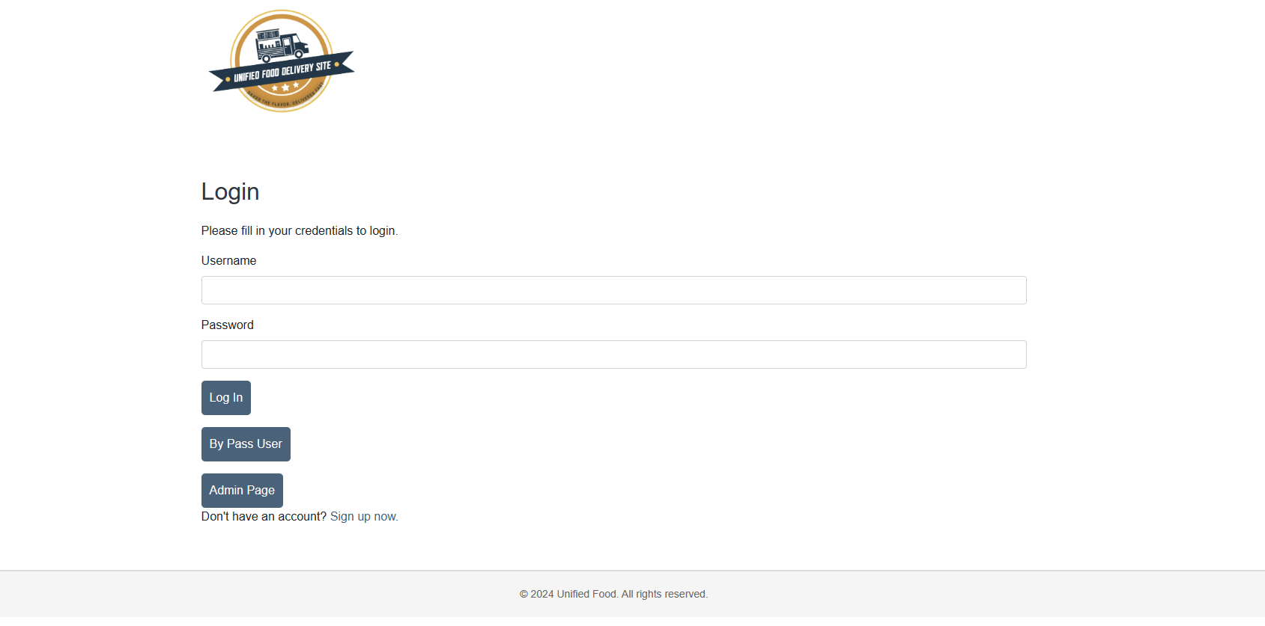
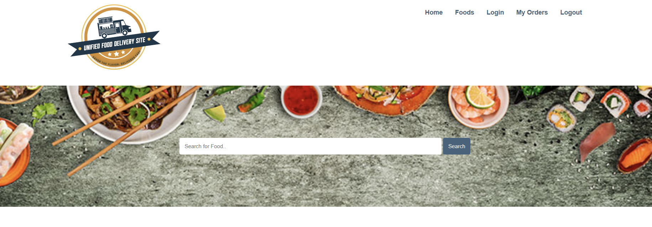
FRONT END USER INTERFACE​
LOGIN WINDOW
HOME PAGE

Slide 12

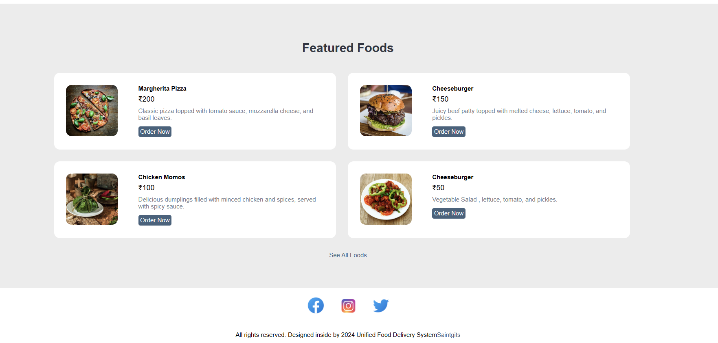
HOME PAGE
FAMOUS
FEATURE
FOODS

Slide 13
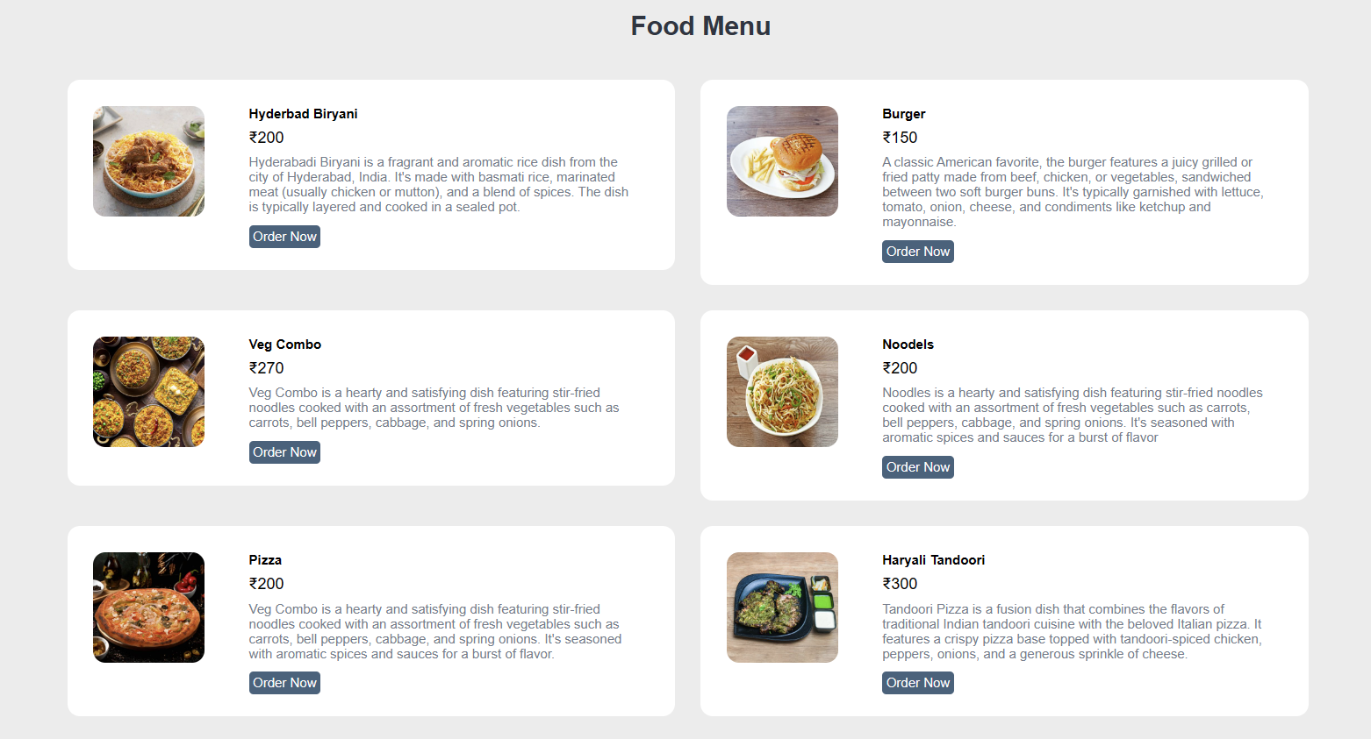
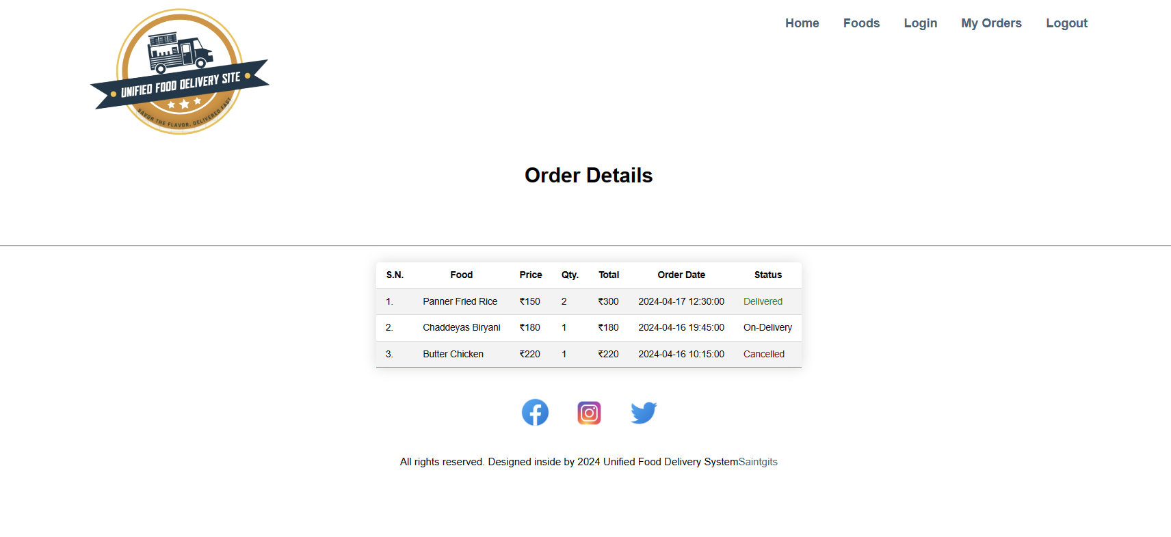
FOOD WINDOW ON NAVIGATION BAR
ORDER SECTION
ON NAVIGATION BAR

Slide 14
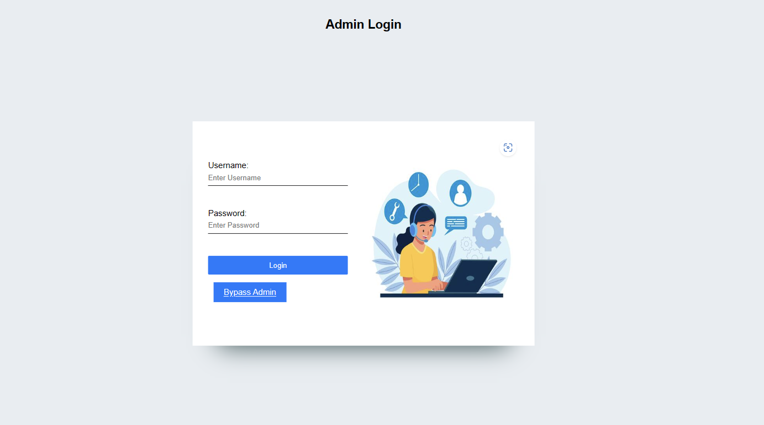
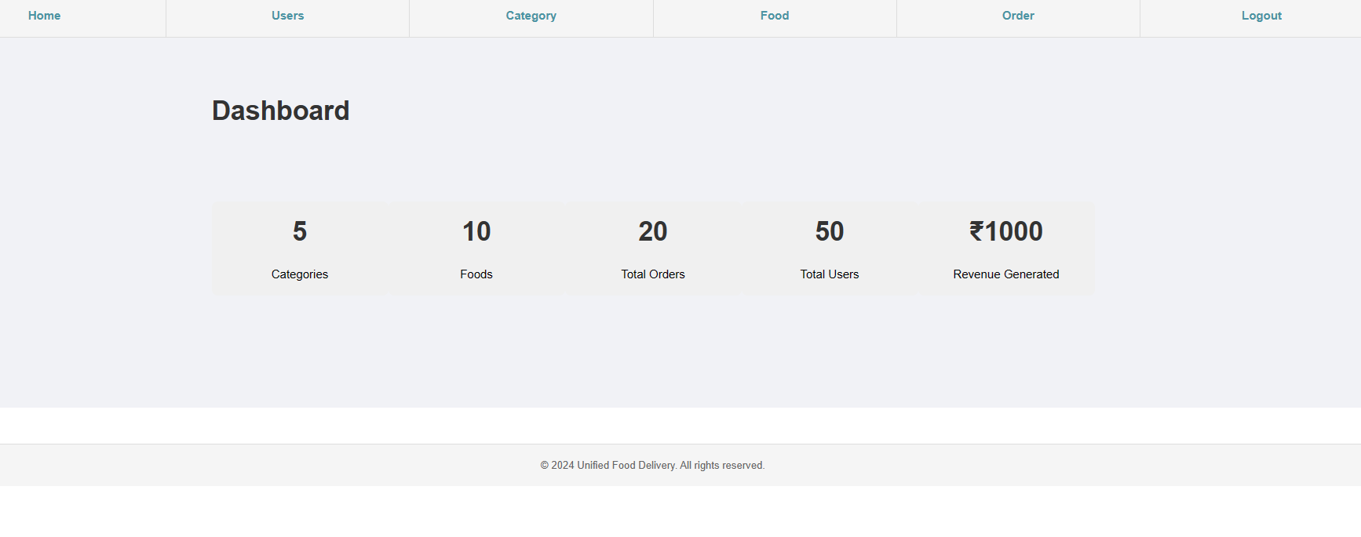
ADMIN LOGIN WINDOW​
ADMIN DASHBOARD

Slide 15
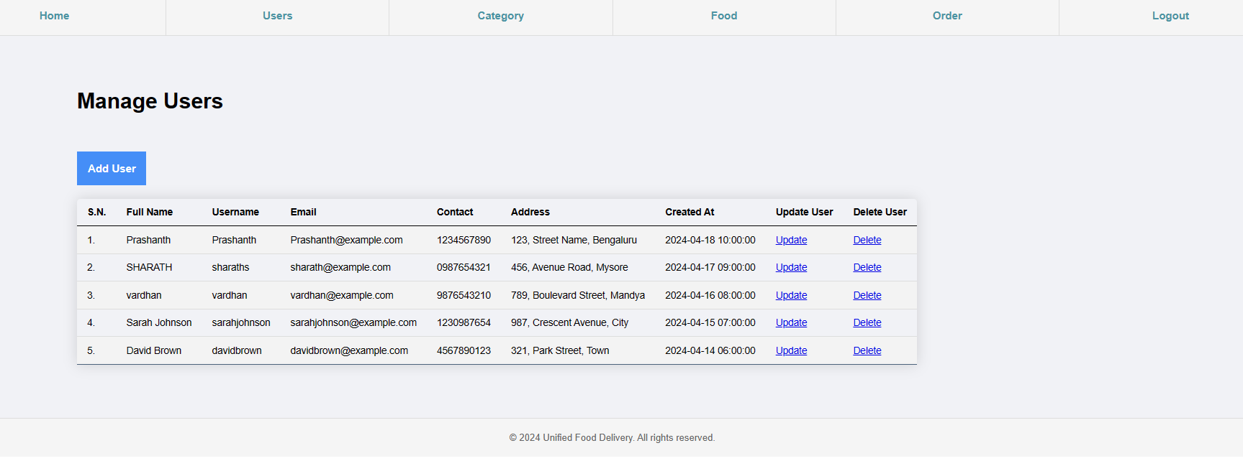
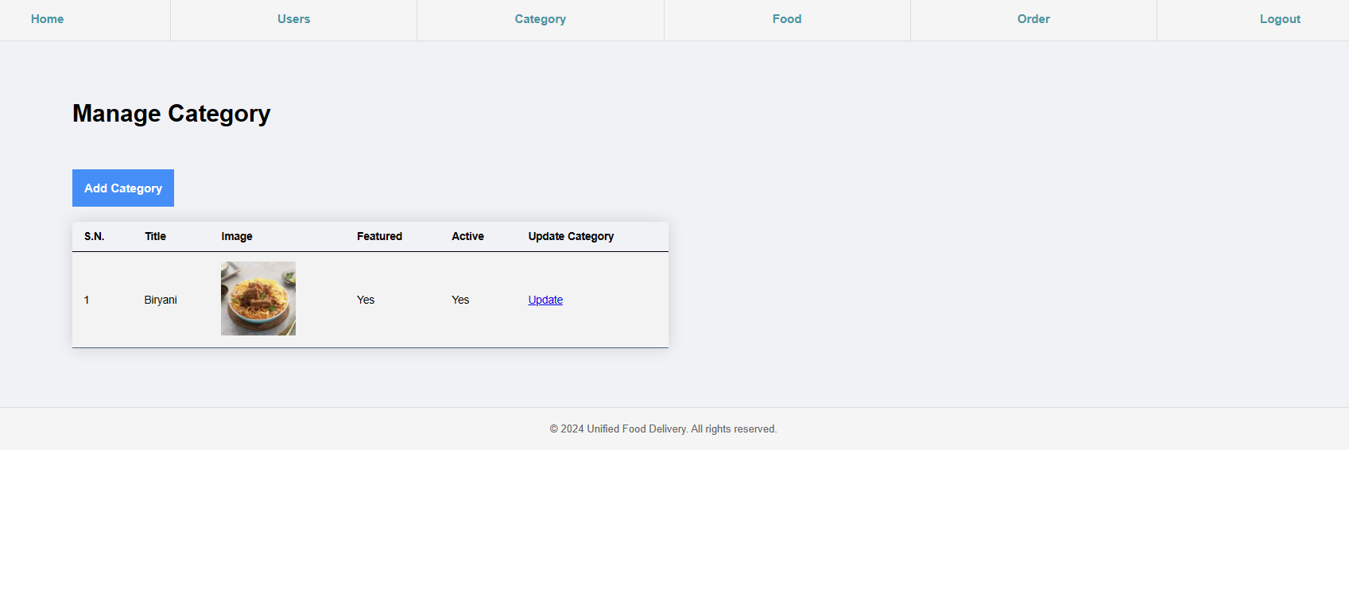
MANAGE USERS
MANAGE CATEGORY

Slide 16
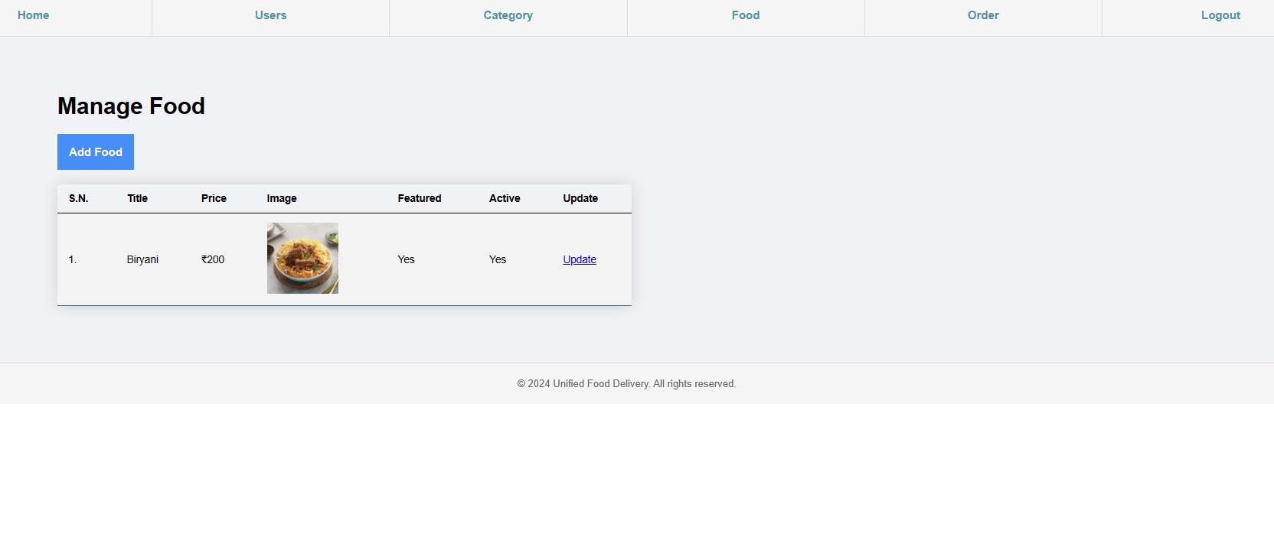
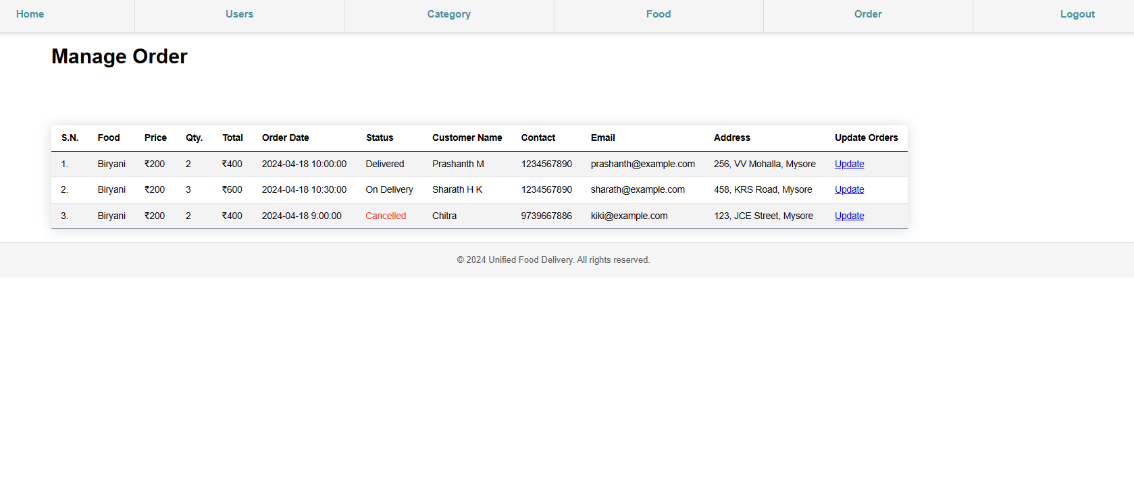
MANAGE FOOD
MANAGE ORDER

Slide 17
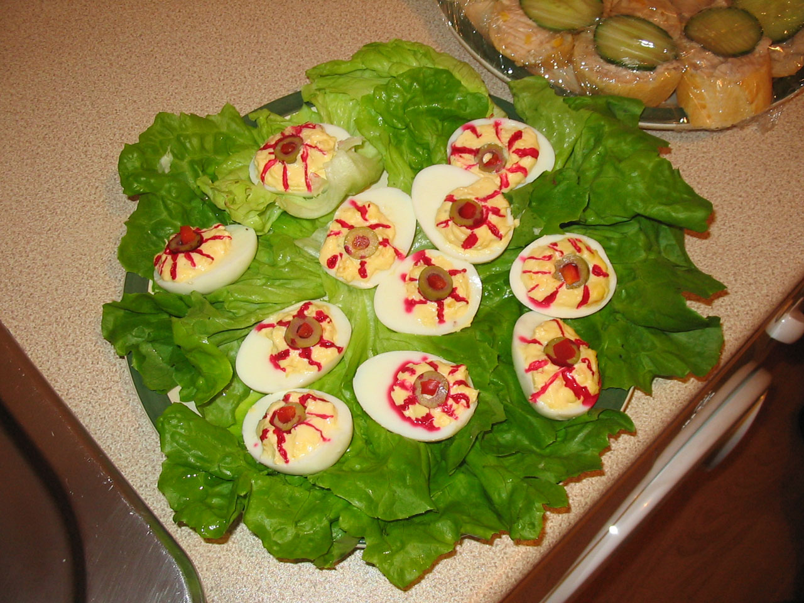
CONCLUSION​
Unified food delivery systems show promise in enhancing efficiency and customer satisfaction.
Despite challenges like integration complexities, empirical evidence indicates notable improvements in delivery times and cost-effectiveness.
Theoretical frameworks highlight the transformative potential and offer practical insights for stakeholders.
Collaboration and innovation are crucial for ongoing optimization, ensuring adaptability and progress in the dynamic food delivery landscape.

Slide 18

REFERENCES​
W3Schools. (n.d.). "HTML Tutorial." [Online]. Available: [https://www.w3schools.com/html/](https://www.w3schools.com/html/)
CSS-Tricks. (n.d.). "A Complete Guide to Flexbox." [Online]. Available: [https://css-tricks.com/snippets/css/a-guide-to-flexbox/](https://css-tricks.com/snippets/css/a-guide-to-flexbox/)
Adobe XD. (n.d.). "Adobe XD Tutorial: A Beginner's Guide." [Online]. Available: [https://www.adobe.com/products/xd/learn/get-started.html](https://www.adobe.com/products/xd/learn/get-started.html)
Nielsen Norman Group. (2022). "10 Usability Heuristics for User Interface Design." [Online]. Available: [https://www.nngroup.com/articles/ten-usability-heuristics/](https://www.nngroup.com/articles/ten-usability-heuristics/)
Medium. (2023). "The Difference Between UX And UI Design - A Layman’s Guide." [Online]. Available: [https://uxdesign.cc/the-difference-between-ux-and-ui-design-a-laymans-guide-9a64e84502ee](https://uxdesign.cc/the-difference-between-ux-and-ui-design-a-laymans-guide-9a64e84502ee)
Harvard Business Review. (2018). "The Food Delivery War Is Still On." [Online]. Available: [https://hbr.org/2018/11/the-food-delivery-war-is-still-on](https://hbr.org/2018/11/the-food-delivery-war-is-still-on)

Slide 19

THANK YOU

